Slide 1
AE4233 Advanced design methods
MDO Practical session 5
Fmincon and sensitivity analysis
Surrogate handling in IDF
Q3DAerosolver-EMWET load mapping
Dr. Ali Elham (a.elham@tudelft.nl)
Dr. Gianfranco La Rocca (g.larocca@tudelft.nl)
Ir. Durk Steenhuizen (d.steenhuizen@tudelft.nl)
FPP

Slide 2
What you need to know to start an optimization with MATLAB
FMINCON settings: options = optimset (…)
Some options you HAVE TO define for your optimization:
  Algorithm: SQP is recommended
  DiffMinChange: not less than 0.01
  DiffMaxChange: not higher than 0.1
  TolFun
  TolCon Finding good values for them is a part of
  TolX your assignment

Slide 3
What you need to know to start an optimization with MATLAB
Some options are optional but recommended:
  Display: Iter is recommended
  PlotFun:
  plotfunctions={@optimplotx @optimplotfval @optimplotconstrviolation};
  See MATLAB help for “optimset” to find the available optimization options for fmincon

Slide 4
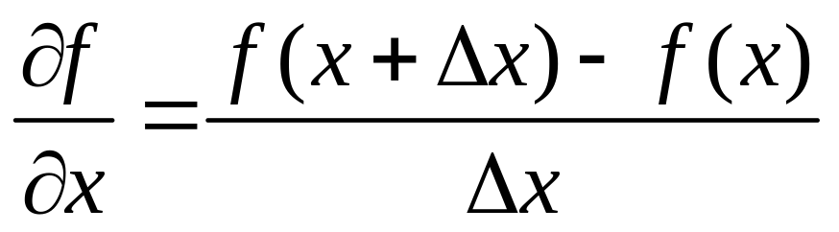
Sensitivity Analysis
Gradient based algorithms need sensitivity of objective functions and constraints with respect to the design variables.
Fmincon uses “finite difference” method for sensitivity analysis:
The value of deltaX should be defined

Slide 5


Sensitivity Analysis
Theoretically
Practical values in numerical analysis ~10^-6
DiffminChange is the minimum value of
DiffMaxChange is the maximum value of
Matlab default value for DiffMinChange is 10^-6

Slide 6
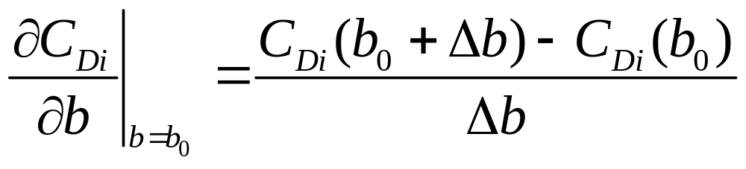
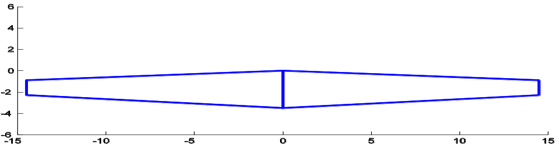
Sensitivity Analysis - Example
Example: Sensitivity analysis of wing induced drag with respect to wing span using Q3D:
b0 = 29m

Slide 7
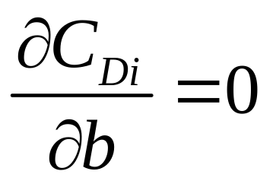
Sensitivity Analysis - Example
For AOA = 2 deg → CDi = 0.0094
Using Matlab default value for :
Running Q3D for new wing span of 29.000001m
  For AOA = 2deg → CDi = 0.0094

Slide 8
Sensitivity Analysis - Example
means b=29m is the optimum wing span for minimum induced drag (other variables are fixed)
Use = 0.1:
  CDi(b=29.1) = 0.0093! Induced drag is reduced!
Q3D cannot see the effect of one micron difference in span on the induced drag, you need to change the span at least a few centimetres to have a change in Cdi
use diffminchange & diffmaxchange to definde deltaX
WRONG

Slide 9
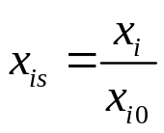
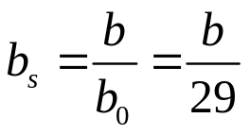

Effect of Scaling
If you scale all the design variables: →
Sensitivity @ b=29m:
is now percentage of the reference value… so means 1% of the initial value of span: 29cm instead of 1cm for a 29m span
If you do not scale your design variables for :
huge effect on objfun
No measurable effect on objfun
For scaled design vector:

Slide 10
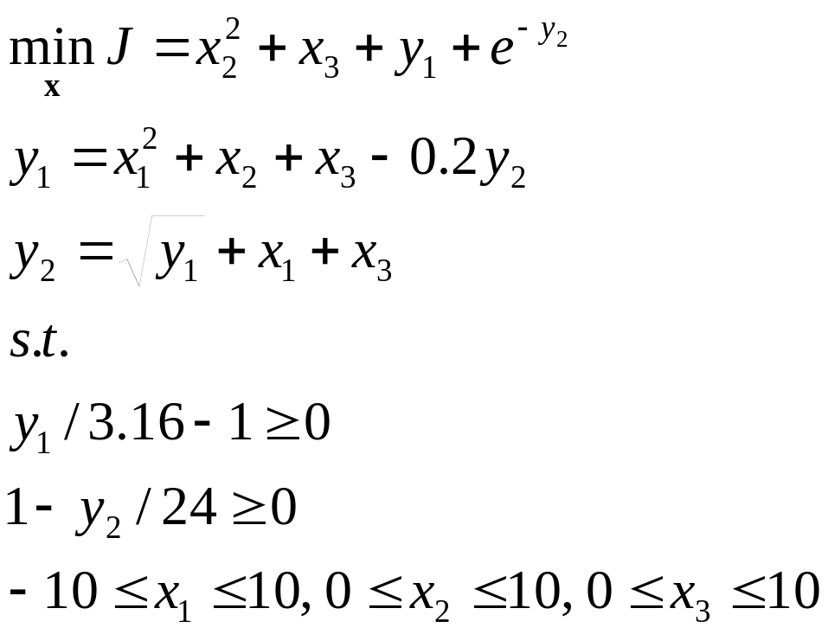
IDF Strategy
From the second tutorial:
In an IDF strategy both the objective function and the constraints are functions of surrogate variables y1* and y2*

Slide 11
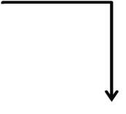


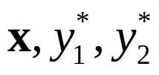
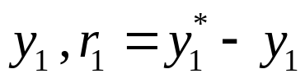

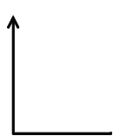
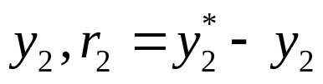
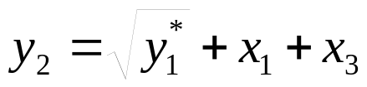


Example DSM (IDF)
SO

Slide 12











Optimizer
Constraints of the original problem
(inequality constraints)
Objfun
Constr.
Consistency constraints on surrogate variables (equality constraints)

Slide 13
IDF approach for wing optimization
Defining surrogate values for the coupling variables
Loads are coupling variables:
In contrast to the weight, which is only one variable, for loads you need to define the spanwise distributions as surrogate variables
Q3D
Loads (lift and pitching moment distribution
Weight
EMWET

Slide 14
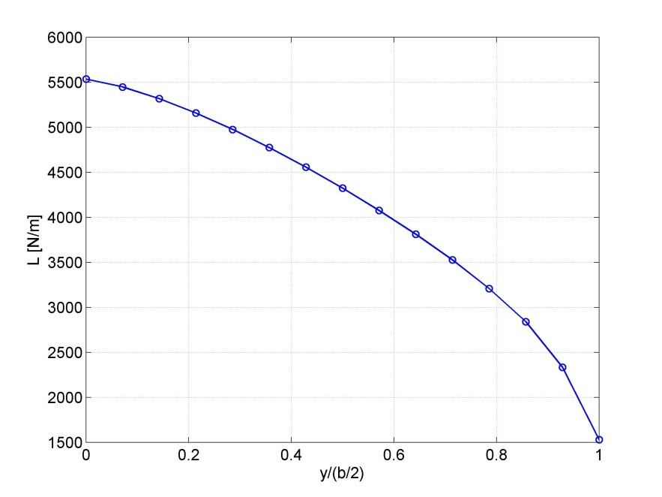
Load distribution using surrogate variables
Approach one:
  Define loads at different points:
  L = [L1 L2 … Li …Ln], Li is the load at yi
  You need at least 15-20 points to have a nice load distribution

Slide 15
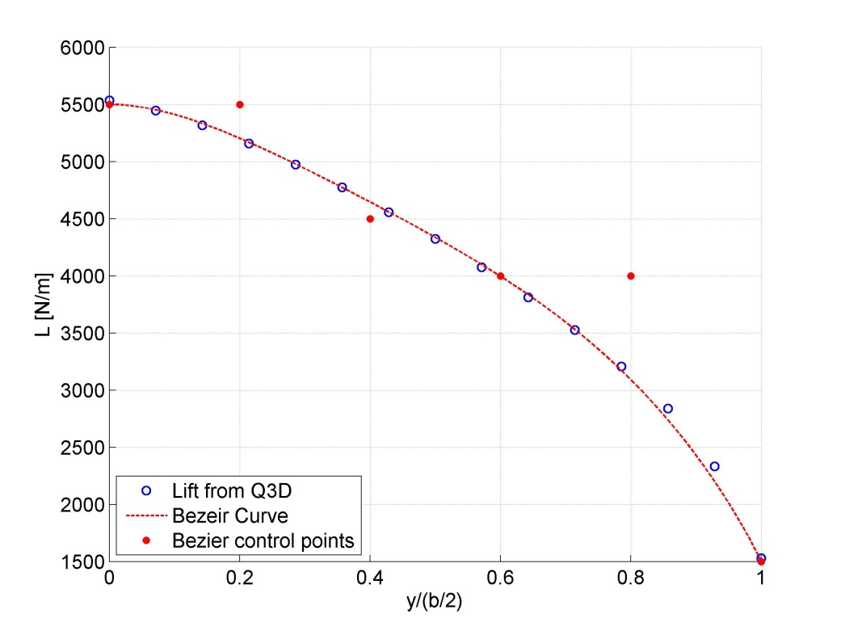
Load distribution using surrogate variables
Approach two (optional):
  Approximate the load distribution using a curve (Bezeir, B-Spline ,etc.) with 5-6 control points
  Define the control point of the curve as design variables
You can fix the spanwise position of the control points and define their weights (y positions) as design variables:
6 vs 15 design variables!
A good approximation of the lift distribution is achieved using a Bezier curve with 6 control points

Slide 16
Making an automatic link between Q3D and EMWET
Download the Matlab codes EMWET-Q3D.zip for connecting Q3D to EMWET from Blackboard
Try to run the code and understand it
Remove all the hard coded numbers in the code and use your design variables. Make an automatic link between the Q3D solver and EMWET.

